Slide 1

2PCS BFX UA-300
Swap Verification Report
Prepared by: PE- Nguyen Nhat Nam
Date : 2022.10.26

Slide 2
#1
Problems Description
RD sent 2pcs Swan PCBA (one OK and one NG unit) in 2022.10.11 to Fii to swap SoC & eMMC.
Fii follow process below to swap SoC & eMMC.
Step | Items | Content | Result
1 | Received RD’s products | Received RD’s products from RD 2022.10.11 | 1pcs OK (SN: YWR0LWN) and 1pcs NG has HDMI voice louder than normal DUT (SN: YWR0LVO)
2 | Baking | Baking PCBA 24h in 45⁰ | Pass
3 | VI & Take X-ray | VI & Take X-ray SoC, eMMC, RAM location to check process issue | Pass
4 | Swap components | 1. Remove OK SoC & eMMC from OK board 2. Remove NG SoC & eMMC from NG board | Pass
 |  | Reball SoC and eMMC | Pass
 |  | 1. Remount: OK SoC & eMMC + NG board 2. Remount: NG SoC & eMMC + OK board | Pass
5 | VI and take X-ray | VI and take X-ray SoC (U1) & eMMC (U6) location to make sure no process issue | Pass
6 | Measure impedance & VF | Measure impedance & VF after swap components | 1. OK SoC & eMMC + NG board: no abnormal 2. NG SoC & eMMC + OK board: PWR_CPU_1V05 & PWR_CORE_1V05 power short.
7 | Check boot up and functions | Check boot up and HDMI + audio function | OK SoC & eMMC + NG board: boot up normal, HDMI + audio function test Pass

Slide 3
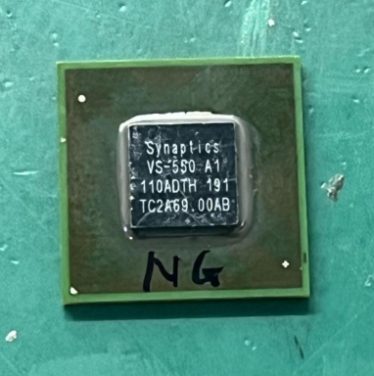
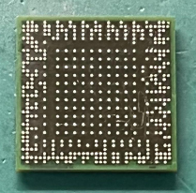

#2
NG SoC & eMMC + OK board
Remount NG SoC & eMMC to OK board follow up process below :
Remove NG SoC & eMMC from NG board
VI
Reball
VI
Remount NG SoC & eMMC to OK board
VI
Check impedance
Check boot up and HDMI + audio function
OK
OK
OK
OK
NG
NG
NG
NG
Scrap
Measure impedance SoC pins and conclusion
Remove NG SoC & eMMC from NG board
After swapped NG SoC & eMMC to OK board, PE measured impedance all power supplies found out L68 & L69 PWR_CPU_1V05 and PWR_CORE_1V05 locations short, please see table below.
Remove NG SoC and measure the pins related to PWR_CPU_1V05 and PWR_CORE_1V05, please see an attachment file.
Location | Des | NG SoC + OK board (Ω) | OK sample (Ω)
L68 | PWR_CPU_1V05 | 1 | 422.3
L69 | PWR_CORE_1V05 | 4.5 | 141.3
NG SoC Top & Bot side VI good

Slide 4
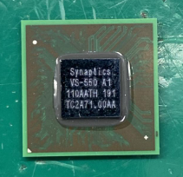
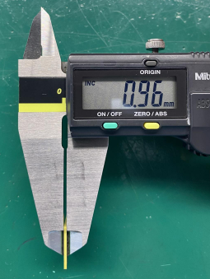
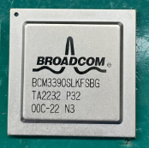
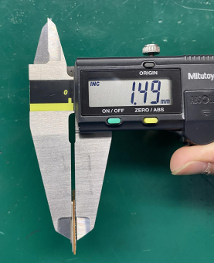
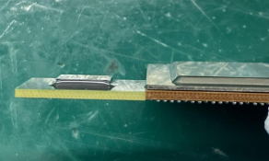
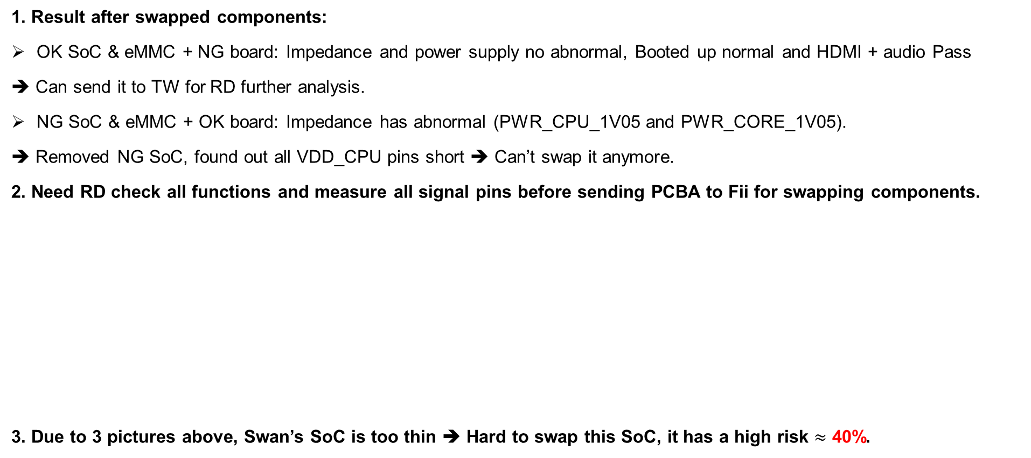
#3
Conclusion
1. Result after swapped components:
OK SoC & eMMC + NG board: Impedance and power supply no abnormal, Booted up normal and HDMI + audio Pass
➔ Can send it to TW for RD further analysis.
NG SoC & eMMC + OK board: Impedance has abnormal (PWR_CPU_1V05 and PWR_CORE_1V05).
➔ Removed NG SoC, found out all VDD_CPU pins short ➔ Can’t swap it anymore.
2. Need RD check all functions and measure all signal pins before sending PCBA to Fii for swapping components.
3. Due to 3 pictures above, Swan’s SoC is too thin ➔ Hard to swap this SoC, it has a high risk $≈$ 40%.
Swan SoC
Others SoC
Thickness comparison

